Slide 1

CISC360 Computer Architecture
Lesson 12
ILP and Superscalar Computers

Slide 2

What is Superscalar?
Common instructions (arithmetic, load/store, conditional branch) can be initiated and executed independently
Equally applicable to RISC & CISC
In practice usually RISC

Slide 3
Why Superscalar?
Most operations are on scalar quantities (see RISC notes)
Improve these operations to get an overall improvement

Slide 4
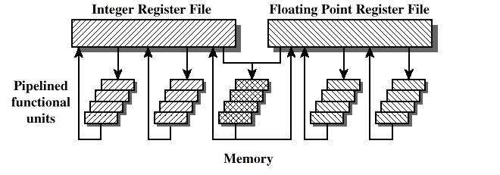
General Superscalar Organization

Slide 5
Limitations
Instruction level parallelism
Compiler based optimisation
Hardware techniques
Limited by
  True data dependency
  Procedural dependency
  Resource conflicts
  Output dependency
  Antidependency

Slide 6
True Data Dependency
ADD r1, r2 (r1 := r1+r2;)
MOVE r3,r1 (r3 := r1;)
Can fetch and decode second instruction in parallel with first
Can NOT execute second instruction until first is finished

Slide 7
Procedural Dependency
Can not execute instructions after a branch in parallel with instructions before a branch
Also, if instruction length is not fixed, instructions have to be decoded to find out how many fetches are needed
This prevents simultaneous fetches

Slide 8
Resource Conflict
Two or more instructions requiring access to the same resource at the same time
  e.g. two arithmetic instructions
Can duplicate resources
  e.g. have two arithmetic units

Slide 9
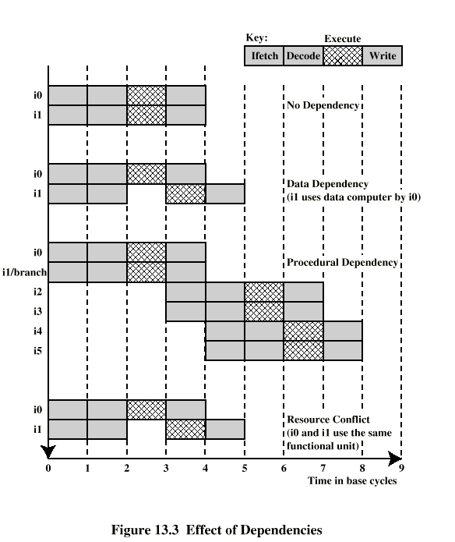
Dependencies

Slide 10
Design Issues
Instruction level parallelism
  Instructions in a sequence are independent
  Execution can be overlapped
  Governed by data and procedural dependency
Machine Parallelism
  Ability to take advantage of instruction level parallelism
  Governed by number of parallel pipelines

Slide 11
Instruction Issue Policy
Order in which instructions are fetched
Order in which instructions are executed
Order in which instructions change registers and memory

Slide 12
In-Order Issue
In-Order Completion
Issue instructions in the order they occur
Not very efficient
May fetch >1 instruction
Instructions must stall if necessary

Slide 13
In-Order Issue
Out-of-Order Completion
Output dependency
  R3:= R3 + R5; (I1)
  R4:= R3 + 1; (I2)
  R3:= R5 + 1; (I3)
  I2 depends on result of I1 - data dependency
  If I3 completes before I1, the result from I1 will be wrong - output (read-write) dependency

Slide 14
Out-of-Order Issue
Out-of-Order Completion
Decouple decode pipeline from execution pipeline
Can continue to fetch and decode until this pipeline is full
When a functional unit becomes available an instruction can be executed
Since instructions have been decoded, processor can look ahead

Slide 15
Antidependency
Write-write dependency
  R3:=R3 + R5; (I1)
  R4:=R3 + 1; (I2)
  R3:=R5 + 1; (I3)
  R7:=R3 + R4; (I4)
  I3 can not complete before I2 starts as I2 needs a value in R3 and I3 changes R3

Slide 16
Machine Parallelism
Duplication of Resources
Out of order issue
Renaming
Not worth duplication functions without register renaming
Need instruction window large enough (more than 8)

Slide 17
RISC - Delayed Branch
Calculate result of branch before unusable instructions pre-fetched
Always execute single instruction immediately following branch
Keeps pipeline full while fetching new instruction stream
Not as good for superscalar
  Multiple instructions need to execute in delay slot
  Instruction dependence problems
Revert to branch prediction

Slide 18
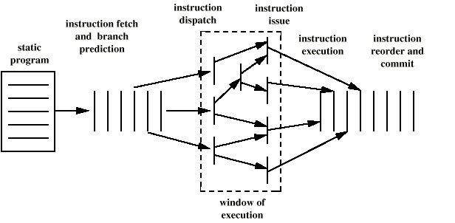
Superscalar Execution

Slide 19
Superscalar Implementation
Simultaneously fetch multiple instructions
Logic to determine true dependencies involving register values
Mechanisms to communicate these values
Mechanisms to initiate multiple instructions in parallel
Resources for parallel execution of multiple instructions
Mechanisms for committing process state in correct order

